Slide 1

Blazor vs Angular vs React
Artsem Kanapliou for .NET Division Research & Development Function
Notes:
Hi!
My name is Artsem. I’m a senior software engineer from the .NET division.
I’ve been with Godel for about 5 years, and for approximately 2 of them I was working 90% of my time on React solutions.
So, I love React and it was interesting to take a closer look at Angular and Blazor.

Slide 2

What are we going to do today?
We will try to compare React, Angular and Blazor
It will be a broad high-level overview
You will get a starting point for your own investigation
Notes:
What are we going to do today?
We will try to compare three front-end solutions: React, Angular and Blazor.
Obviously, It’s not possible to cover everything and my goal is to give as broad a comparison as possible so that you have something to start with if necessary.

Slide 3
Those useful UI frameworks
Speed ​​up development
Consistency and Uniformity
Community support
Reduction of efforts
Notes:
What are UI frameworks and what are they for?
As you may already know -- UI frameworks are collections of pre-written code and tools, designed to streamline the development of user interfaces.
They provide a structured way to build and manage elements of an application.
Typically, if you use any popular UI framework:
- you will get faster development (because you don’t need to worry about common problems)
- your code will be written in a clean and uniformly styled way
- you will get tested framework code which constantly gets improved by a community and a huge knowledge base with documentation
- overall development cost and amount of effort will be lower than if you must create UI tooling from scratch

Slide 4



General information
React by Meta (former Facebook), latest version 18.3.1
UI library
JavaScript/TypeScript as primary language
Angular by Google, latest version 18.0.4
Web framework
TypeScript as primary language
Blazor by Microsoft, latest version 8.0.7
Web framework
C# as primary language
Notes:
React:
A JavaScript library used for building user interfaces. Although it’s not a framework we will be referencing it as one, for the sake of simplicity.
It was developed by Facebook and has become one of the most popular libraries for front-end development.
It supports building components and efficiently updating the UI when data changes.
Angular:
A web application framework developed by Google.
Angular is known for its strong opinions on how applications should be built. It includes powerful templating, dependency injection, and an extensive CLI.
Blazor:
A web framework developed by Microsoft that allows developers to build interactive web UIs using C#.
It's part of the .NET ecosystem and aims to leverage the power and familiarity of C# and .NET for web development.

Slide 5
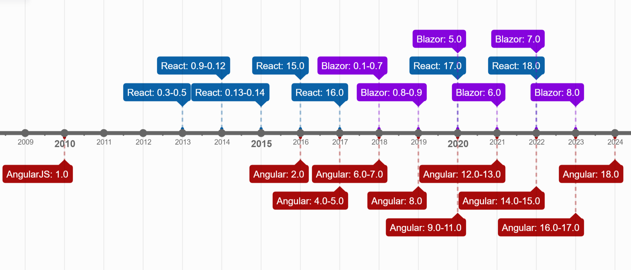
Public releases timeline
Notes:
On this slide you can see timeline for major public versions releases of Angular, React and Blazor.
Angular history is the oldest one of those three, with first release in 2010.
Almost three years after the first Angular release the world saw a new React framework.
The youngest framework in our comparison is Blazor with first publicly available version released in 2018.
We can see that all those frameworks are under constant process of improvement.

Slide 6
Source code and package
 | React | Angular | Blazor
Source code available | github.com/facebook/react | github.com/angular/angular | github.com/dotnet/aspnetcore/tree/main/src/Components
Main package name | “react” npm package | “@angular/core” npm package | “Microsoft.AspNetCore.Components.WebAssembly” Nuget package
Notes:
There are source codes as well as issue trackers and development history publicly available on Github.
But Blazer doesn't have a separate repository unlike other frameworks. It’s part of aspnetcore development and hence located in corresponding repository.
Even though Angular was developed earlier than React, you can already see that React is far beyond its competitors by repository popularity and amount of daily library downloads.
(of course, npm download statistic can’t be directly transferred to the number of library users, but those are incredible numbers for React anyway).

Slide 7
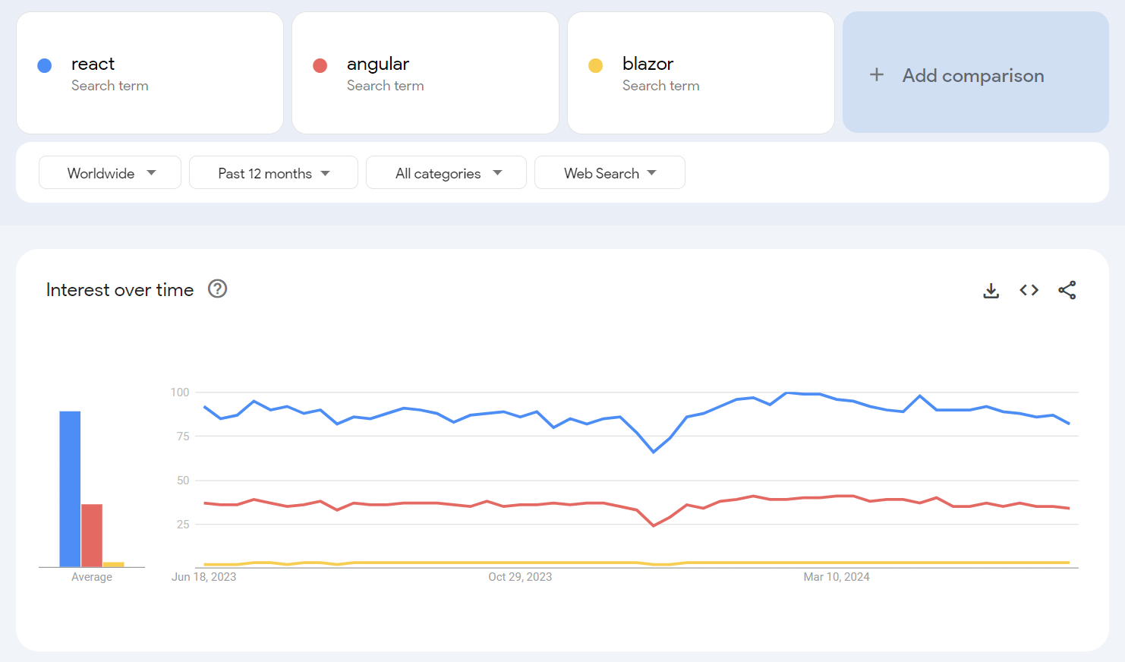
Google trends
Notes:
Here is a final screenshot which basically proves the same things as our previous slide – React is the most popular library out of the three considered.

Slide 8
How can I deliver my UI code to a user?
Notes:
Although it is possible to use React, Angular and Blazor for a server-side rendering, today we will be comparing their usage in client’s browser.
We'll start with a general overview of how our code gets to the user.

Slide 9
Dev side
Write components
Client side
The magic of build
Render process
Load page
Configure build process
Initialize framework
Navigate to a site
Update the DOM based on a change detection
Run build tool
Load index.html
Get static files
Download and execute JS
Render the updated DOM
Upload files to a web server
Notes:
If we are talking about all three frameworks, the process will be pretty much the same.
All of them using component-based model, so you’ll be starting with writing components.
You will have to build you code so that it become a bunch of static files.
Those static files will be served from a web server of some sort (be it a static file hosting or some runtime serving those files).
As soon as user opens your page, he will be loading index.html file and your code will be downloaded and executed.
This process of code execution will lead to framework initialization and as soon as a framework is up and running it will start application rendering and user input handling.

Slide 10
What do I need to know to build?
Each framework requires basic knowledge of Web Development (HTML, CSS, JavaScript, HTTP)
Each framework implements routing, data binding, event handling, state management, and components lifecycle in a slightly different manner
Notes:
Apart from basic web development knowledge, you must get used to framework specifics before being a confident framework user.

Slide 11
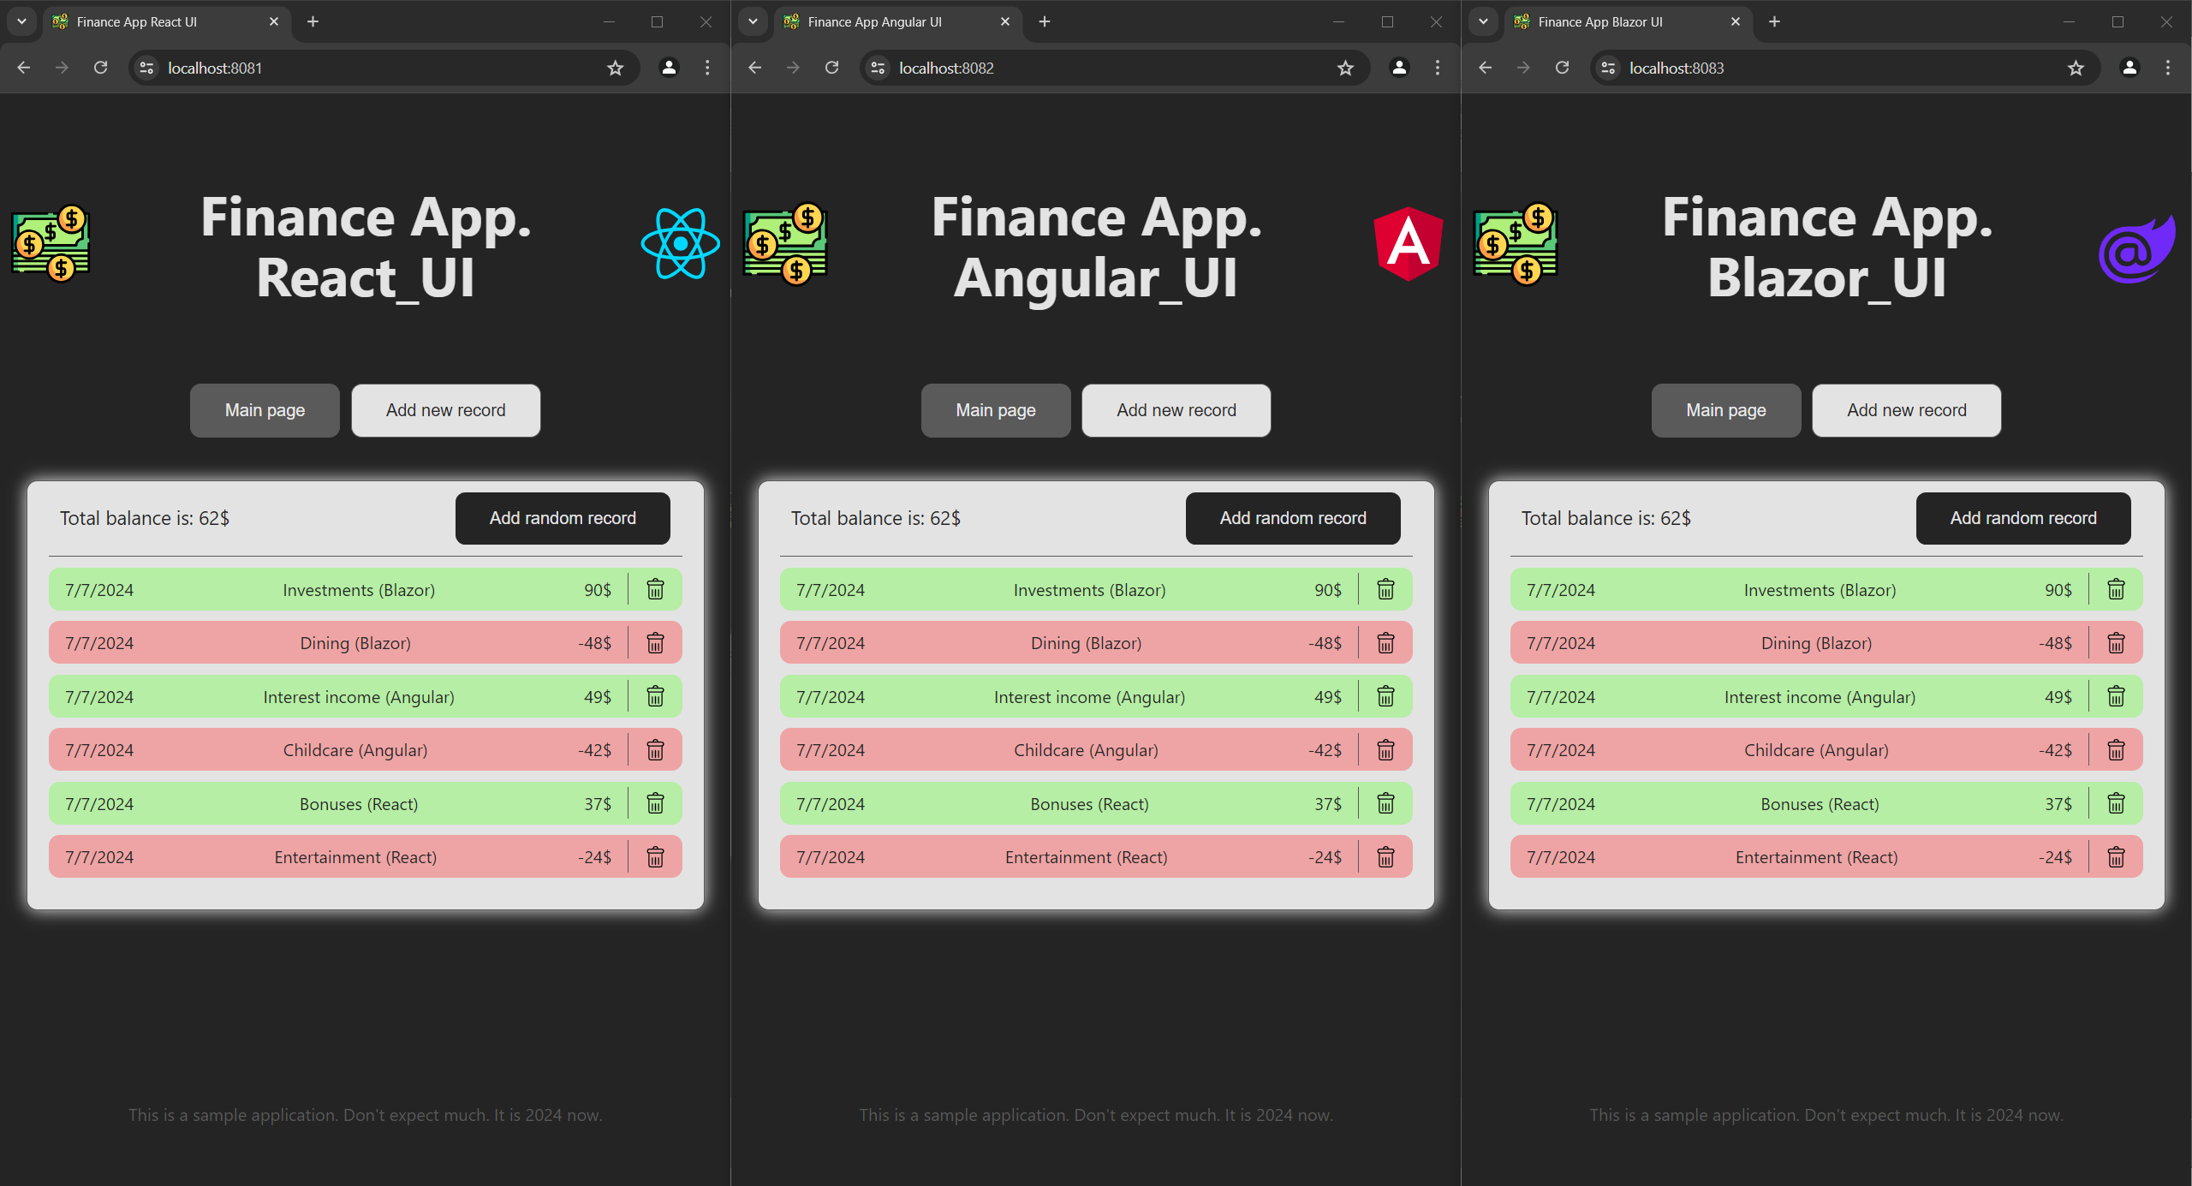
Application example
Notes:
I wrote three identical applications using three different frameworks. So, let’s jump to our code now.

Slide 12
It’s demo time!

Slide 13
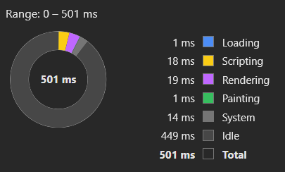
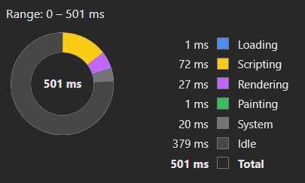
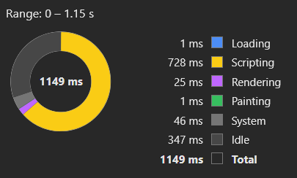
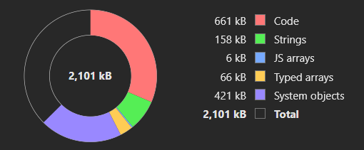
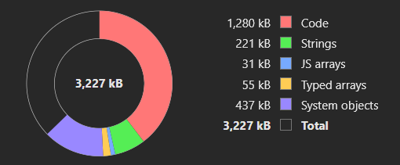
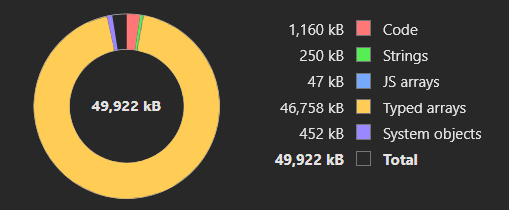
Applications comparison
 | React | Angular | Blazor
Production bundle size (not compressed) | 175 Kb | 321 Kb | 14 Mb
Paint time (FP, FCP, LCP metrics) | ~392 ms | ~478 ms | ~1.10 s
Runtime memory snapshot size | 2.1 Mb | 3.2 Mb | 49.9 Mb

Slide 14
React insights
Pros:
A lot of examples and documentation on the internet
A lot of libraries for almost any use case
The whole UI can be written using a single language and technology stack
As flexible as you can imagine, access to almost every aspect of configuration
Suitable for applications of any scale
Cons:
Must be used in conjunction with other libraries to build a complex application
You must be familiar with JS
Easy to build in a messy way if you are not experienced

Slide 15
Angular insights
Pros:
Has defined structure and preferred ways of building
Easy to find examples on the internet
Can be enriched with external libraries
You can build complex apps out of the box
Rich configuration options
Cons:
May be too complex for a simple application
You must learn a lot of the framework aspects to build a good app

Slide 16
Blazor insights
Pros:
Intuitive components building if you are familiar with the concept
All basic things can be done purely using C#
Relatively easy to get a working application even if you have never touched Blazor
Cons:
Small amount of ready to use libraries
Hard to implement sophisticated things
Hard to find relevant examples and documentation on the internet
Not everything can be done using C# (JS interoperability concept)
Bigger bundle size and hence slower initialization

Slide 17
Instead of conclusion
There is no silver bullet for UI building
Blazor is an interesting technology to consider
My personal choice is still React

Slide 18

Thanks for your attention!
Repository with code and presentation:
https://bit.ly/frmwrks1
Contact point:
Artsem Kanapliou (a.kanapliou@godeltech.com)

Slide 19
Any questions?

